Slide 1
POWER BI PROJECT OMIs 661
HEMANTH POTHINENI [Z1948105]

Slide 2
PROJECT SUMMARY
Our project describes brief information about the revenue from selling goods in each state by the information provided by WIDEWORLDIMPORTERS DW. This project explains what is the position of the state in selling its goods and graphs of sales each month. We divide the information and placed it on SIX pages named “ ORDERS, SALES, STOCK, MOVEMENT, PURCHASES & TRANSACTIONS “ and these six pages will explain the stock details and sales report of the given information. Data cleaning - We remove the Null & the irrelevant rows and we rename some of the columns.

Slide 3
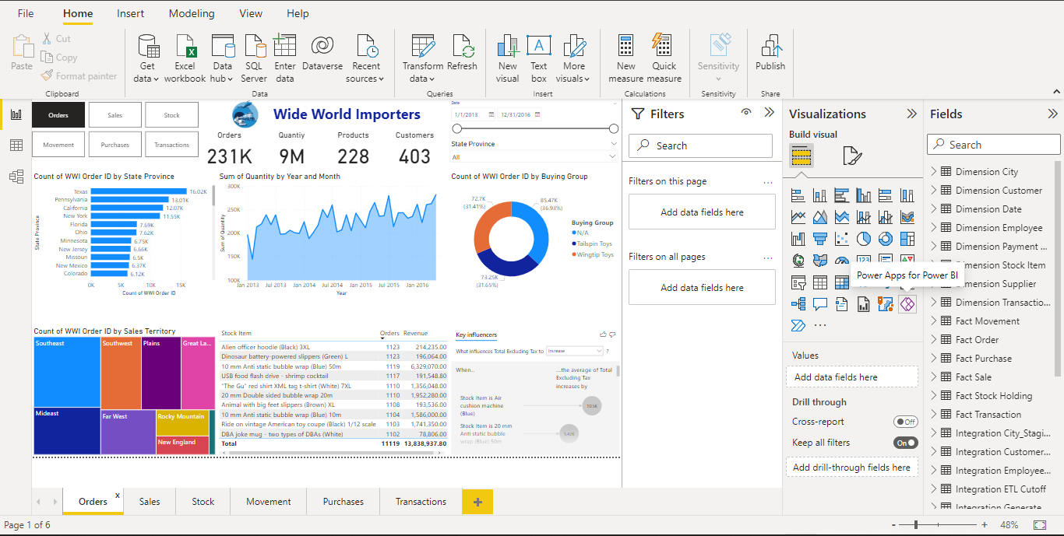
orders

Slide 4
orders
I include the details of the Order ID by State, Sales territory, Buying group, revenue by year and month, and the key influencers on this page.
Oder ID by state – For this graph, we take the state province and WWI Order ID from the fields. This graph shows the orders from the different states Texas has the highest orders and Hawaii has the lowest orders.
Revenue by year – The Revenue from the orders has ups and downs and we can’t see consistency in the revenue graph.
Orders By Sales Territory – Southeast has the highest sales in the territories with orders of 51167 and external territories with orders of 2938.
Order by buying group – Highest purchasing group from WWI is N/A with 85.47K and Tailspin Toys (73.25k), and Wingtip toys (72.7k) follow.
Key Influencers show the average total excluding taxes by stock item and the total cost excluding the tax by product.
Recommendations
I would recommend improving sales in the states and territories where the orders are low, which is improving the marketing for ex., Hawaii is an Island and the population is very low but it’s a tourist spot according to that we need to improve the marketing strategies and advertise about the product in rush areas which helps to increase the sales.

Slide 5
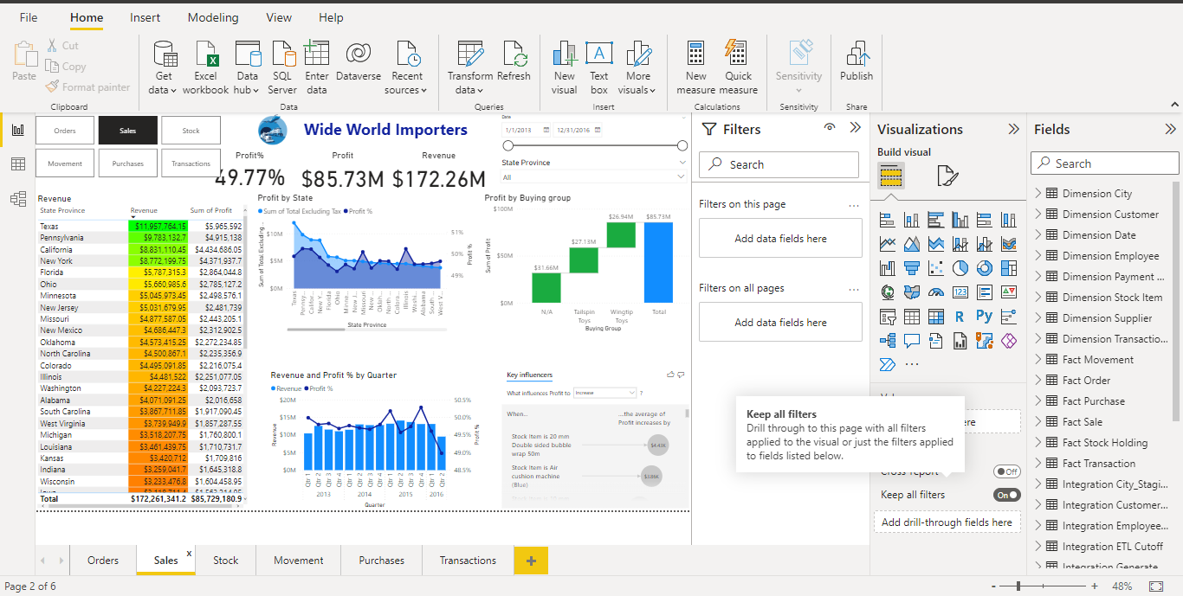
SALES

Slide 6
SALES
The sales page had the revenue chart, profit by state, % of profit per quarter, profits by buying group, and the key influencers. This page shows profits and revenue-generating by each state in the US according to WWI information.
Revenue graph shows the sum of revenue and profits per state by excluding the tax and the color indicates the range of profits according to that state.
Profit by state shows a couple of graphs briefs about the sum of revenue and profits gain by the state.
Revenue by Quarter – this graph explains the profits % for every quarter for each year according to the source information
Key Influencers – we use the stock item and profits for the key influencers as fields show the average profits increase by the products.
Recommendations
We can observe the graphs shows the profit % was rapidly dropping every year, I would recommend that to reduce the operating cost of the products and to increase the order value which helps to grow the profit % in sales revenue.

Slide 7
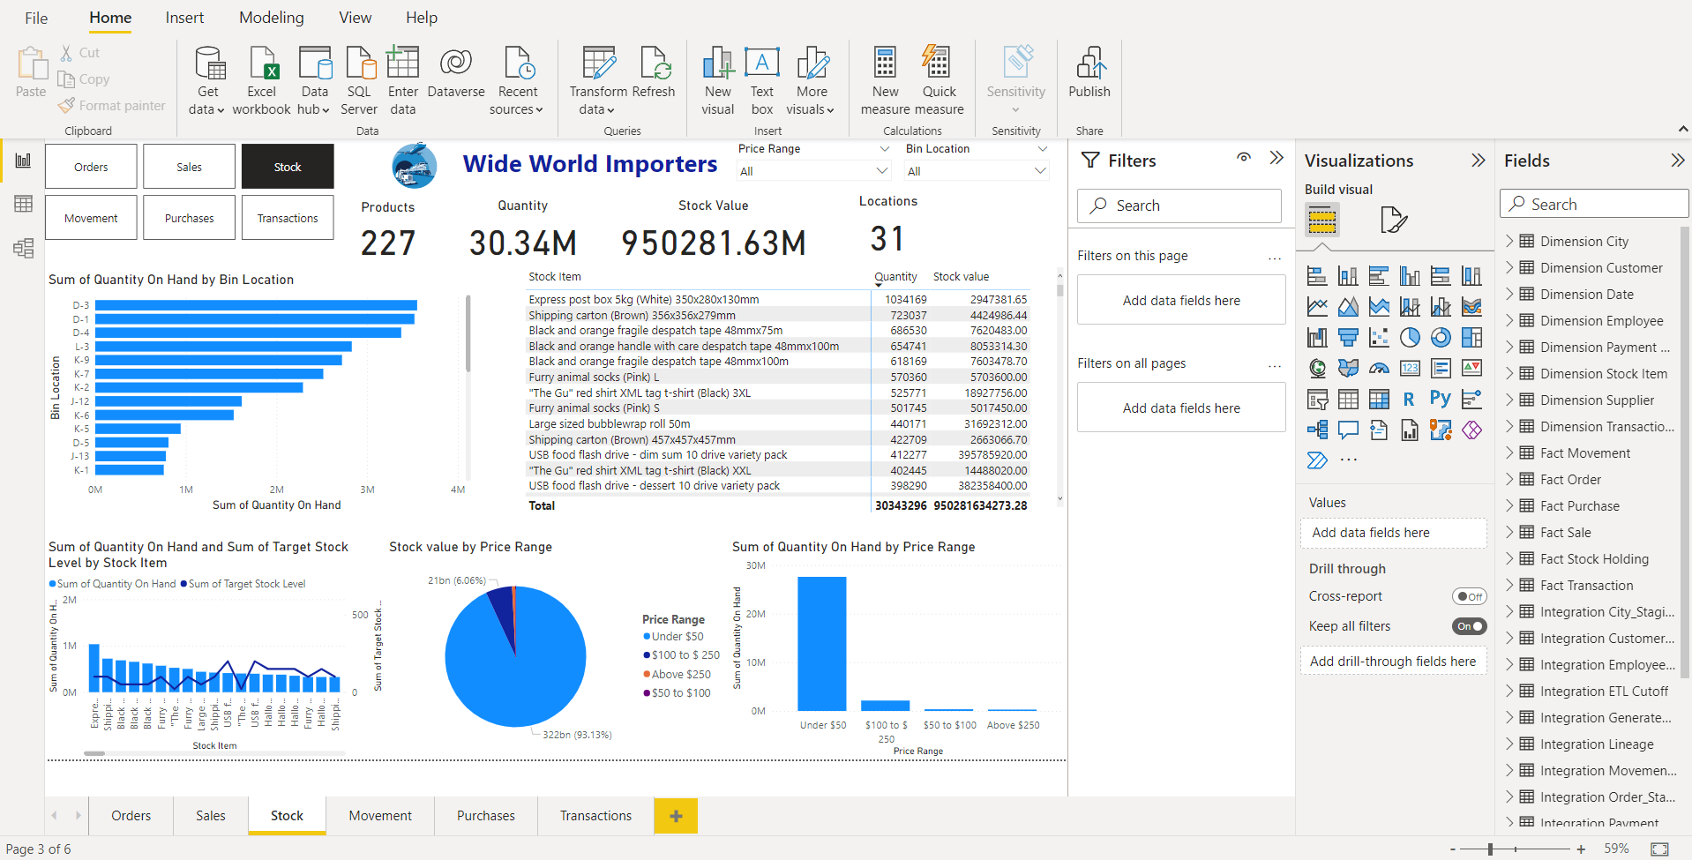
Stock

Slide 8
STOCK
The stock page has filters for the entire report page i,e Price range and Bin Location. This page shows quantity and the stock items, quantity of stock and stock value.
Sum of quantity of hand by bin location.
Total Stock items along with their quantity and Stock value.
Stock Value by Price Range.
Sum of quantity on hand and sum of target stock level by stock item.
Key Influencers – Products , Quantity , Stock Value, Locations.
Recommendations
We can see that for few stock items, the target level is little higher, by this we can are trying to recommend that certain stock items need to be replenished.

Slide 9
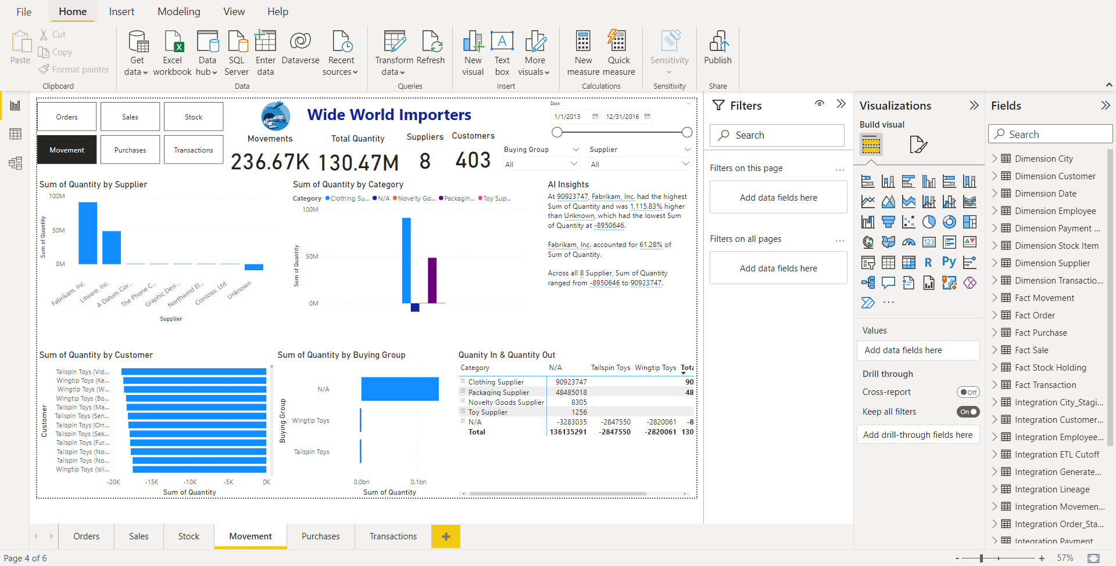
MOVEMENT

Slide 10
MOVEMENT
The stock page has filters for the entire report page i,e Date, Buying group, Supplier. This page shows quantity in and quantity out of the bin.
Sum of quantity by supplier.
Sum of quantity by customer.
Sum of quantity by Category.
Quantity in and Quantity out.
Key Influencers – Movements, Total Quantity, Suppliers, Customers.
Recommendations
We can filter and check which Supplier provides what category of items, as well which supplier provides the highest quantity of stock. We can even check which buyer purchases a lot from which group of suppliers and make some relevant recommendations.

Slide 11
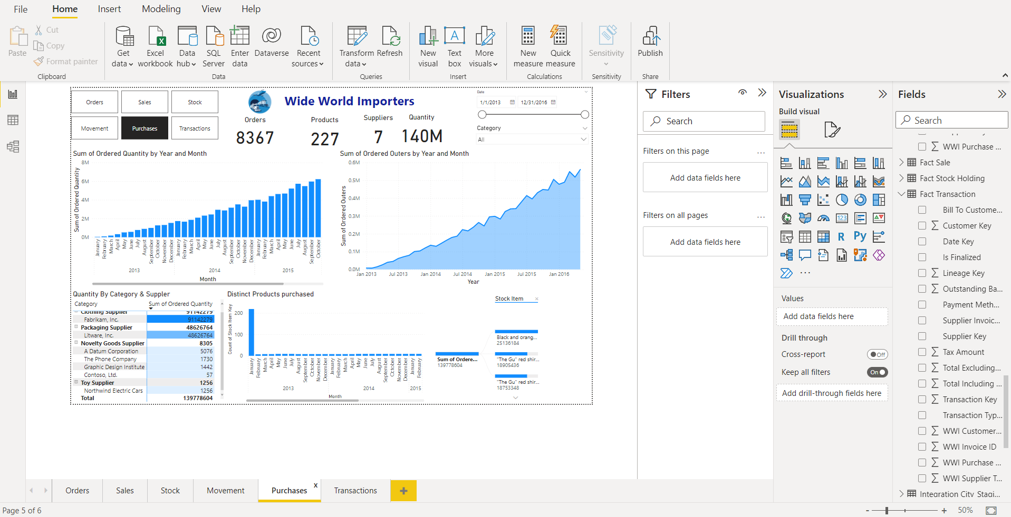
Purchases

Slide 12
Purchases
In the Purchases, the clustered column chart shows the quantity that was ordered based on the month and their respective years.
In the Stacked Area Chart, we show the sum of no of ordering packages that were ordered by year and month
the third visual, ie. the matrix shows the quantity that was ordered, based on category and supplier
the clustered column chart shows the no of distinct or unique products that were bought every month
in the decomposition tree, the sum of the ordered quantity allows you to select from 3 different options, like the products which were the highest selling, lowest selling, and stock items in the order
we also added slicers to the visuals to make them interactive and easily accessible to the user.
Recommendations:
The number of products ordered generates more money than the number of packages ordered, but I would suggest raising even the number of order packages to boost profits for both the WWI and the suppliers.
Instead of investing in new or different items, they should primarily concentrate on growing the ones that are already making them a solid profit, unless the product's functionality is excellent.

Slide 13
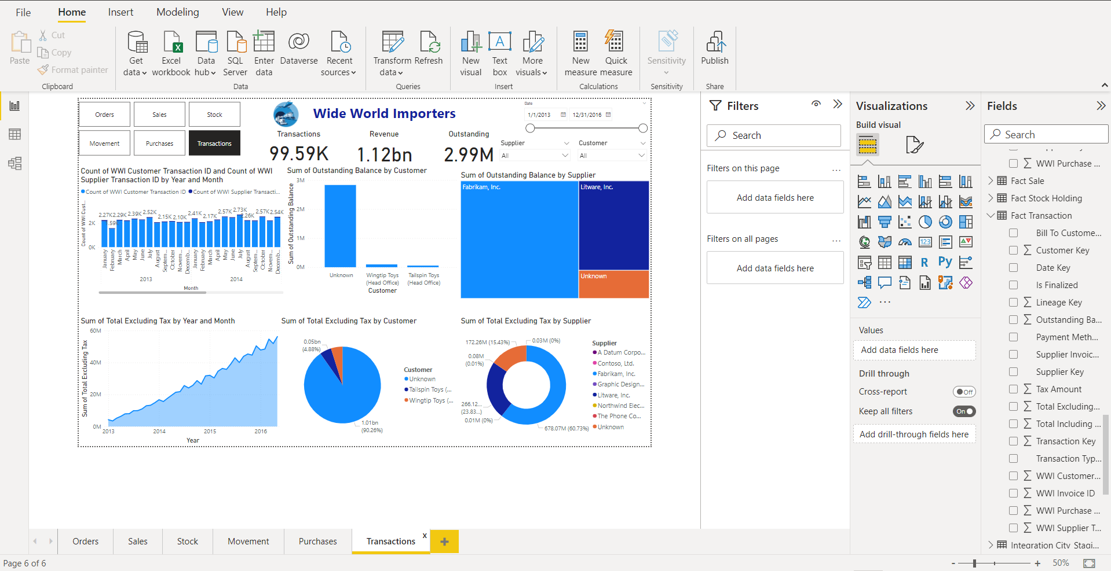
TRANSACTIONS

Slide 14
Transactions
On the Transactions Page, in the stacked column chart we show the counts of customer and supplier transactions by year and month respectively.
in the stacked area chart we show the total revenue generated excluding tax by the company by respective year and month.
In the clustered column chart we show the customers who have an outstanding balance to the company
The pie chart shows the revenue generated by customers
the donut chart shows the revenue generated by suppliers
the treemap shows the outstanding balance that the company has to pay to the suppliers
Recommendations:
Since client transactions outnumber supplier transactions, they must purchase more goods from suppliers to keep up with rising consumer demand, which could boost their profit.
There are only three primary suppliers that WWI purchases from, so they must make sure to speak with other suppliers and purchase from them as well in order to increase sales and satisfy client demand.

Slide 15
THANK YOU

